Slide 1

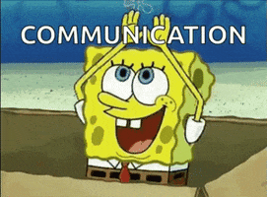
Communication in customer service
Charleny
Garcia

Slide 2
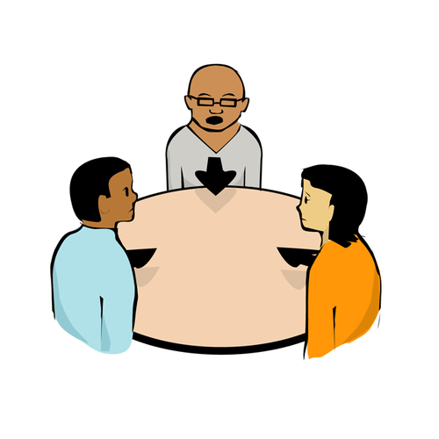
Communication is not only based on: one person speaks and the other listens, there’s more than word in those interactions.And we can differentiate communication in these types:

Slide 3
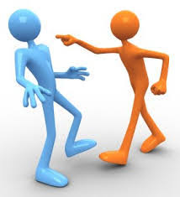
Aggressive
It doesn’t feel like a kind conversation and it's not easy to share ideas with the other person.

Slide 4
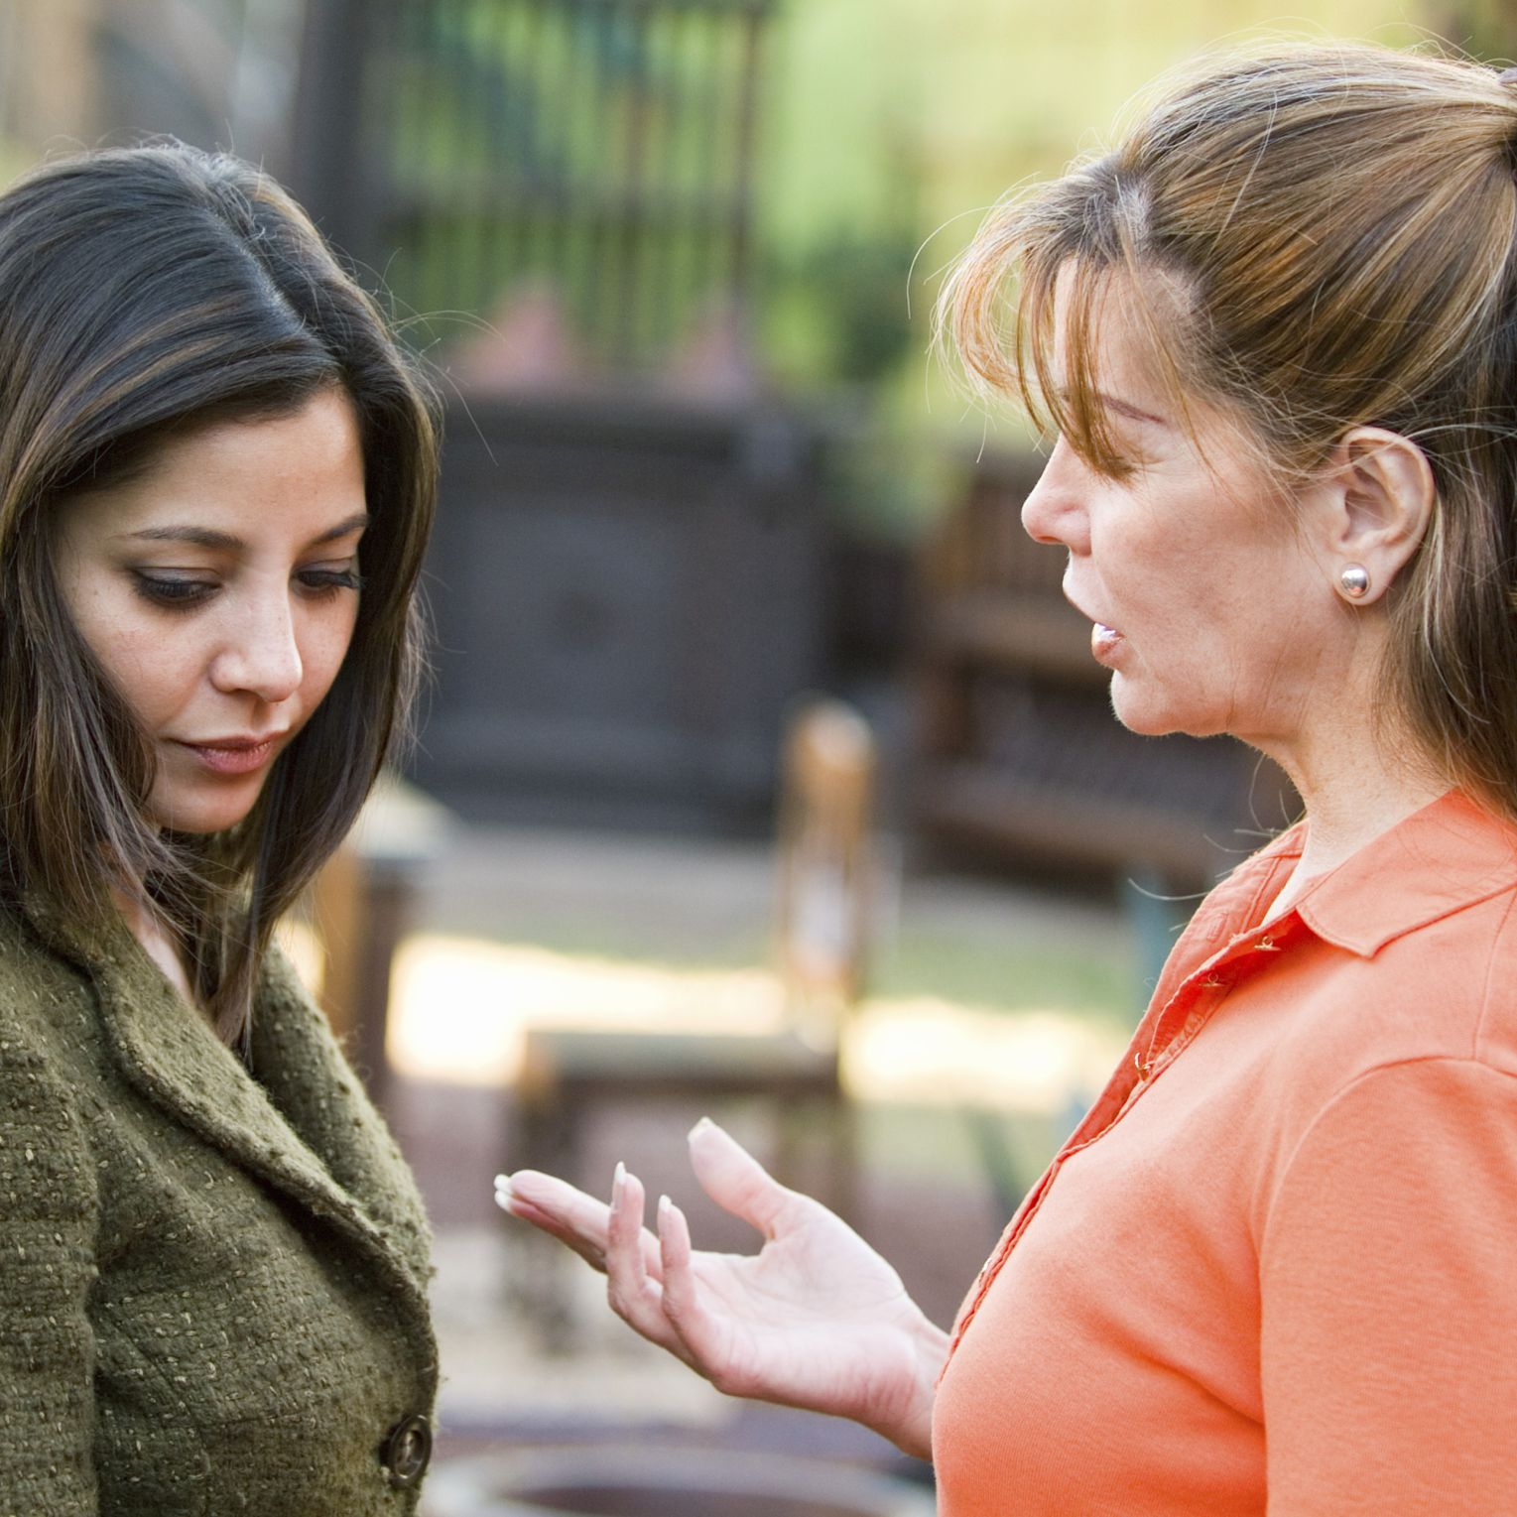
Passive
If the agent is an extremely passive communicator, the customer will take the ownership of the interaction and this can make more difficult to have an agreement or the best solution for the customer.

Slide 5
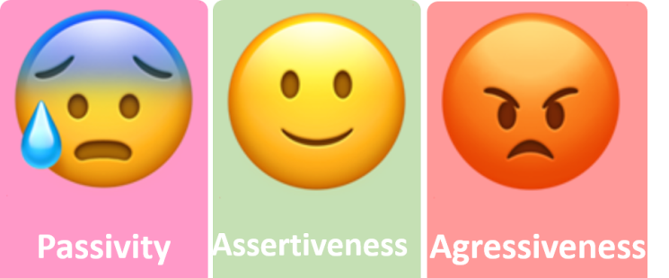
Assertive
This is the style that is between aggressive and passive, and this one helps the agent to take the customers issue and offer a personalized solution with confidence.

Slide 6
Levels of understanding

Slide 7

Level 3
The person is paying no attention to what the other has to say and is not present in the conversation.

Slide 8
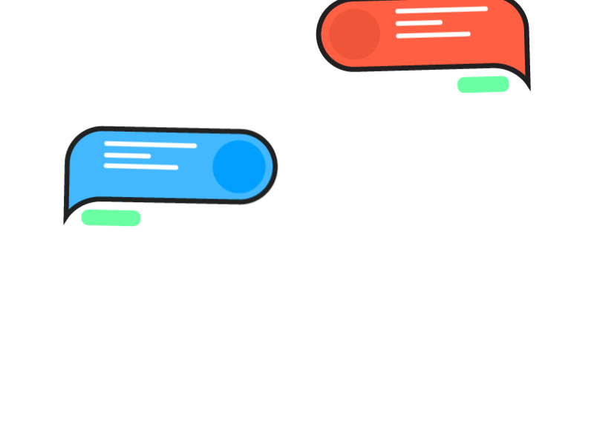
Level 2
Is paying attention but not necessarily taking the real meaning of what the other person is saying.

Slide 9

What we aim for is...

Slide 10
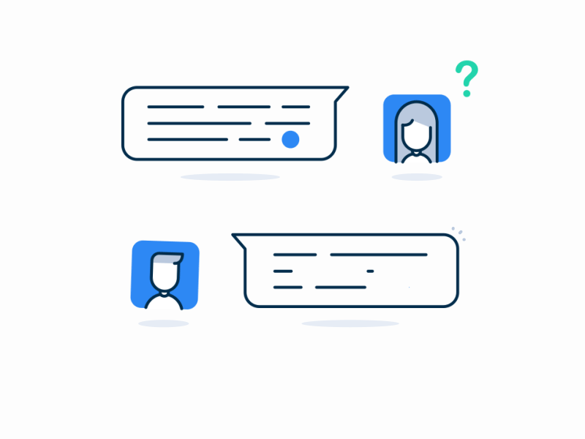
Level 1
The person is paying attention to every aspect of the interaction and making sure that is getting all the relevant information to give the right answer.

Slide 11
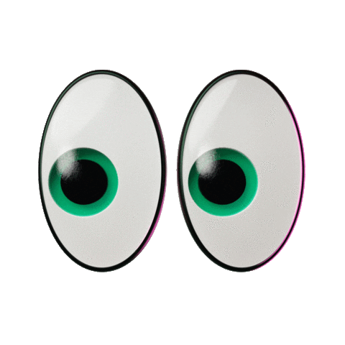
To have a good interaction with customers we need…

Slide 12


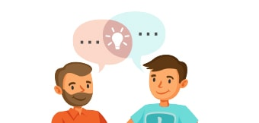
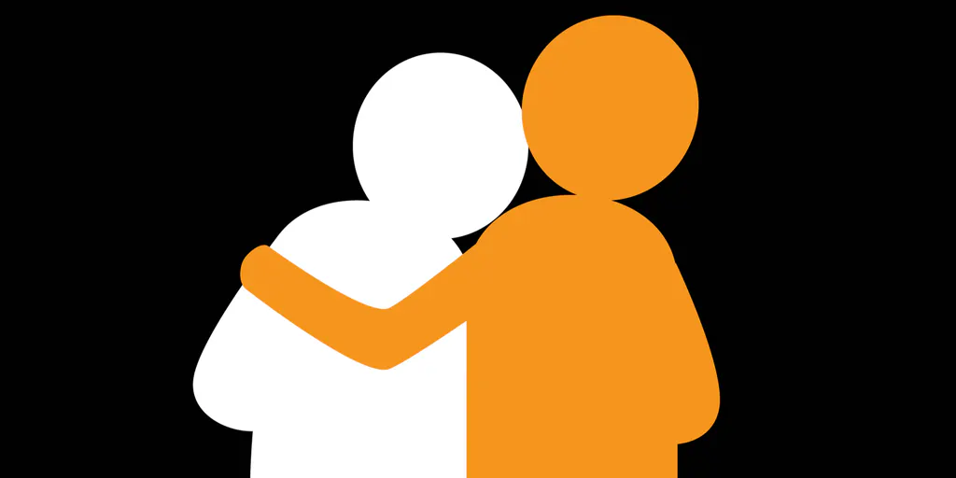
Patience
Timeliness
Clear communication
Empathy

Slide 13
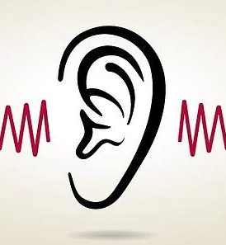


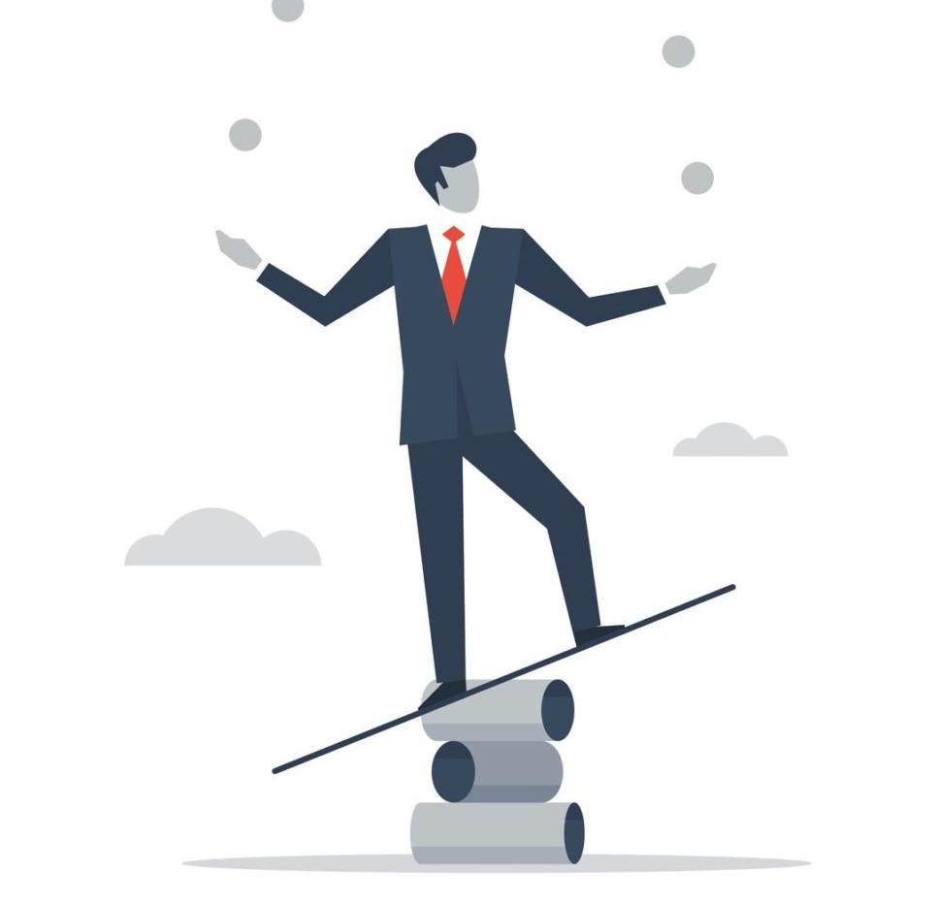
Attentive listening
Organization
Adaptability
Willingness to go the extra mile

Slide 14
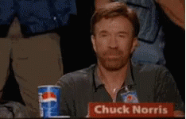
At the end of the day, being empathetic is the key when dealing with customers.

